Slide 1
Data Science and Big Data Analytics

Slide 2
What is Data Science?
Data Science is a field that deals with collecting, analyzing, and interpreting data to find useful information and help in decision making.
In simple words:
Data Science turns raw data into meaningful knowledge.

Slide 3
(Definition)
Data science is the study of data used to extract meaningful insights for business decisions.
It combines mathematics, computing and domain knowledge to solve real-world problems and uncover hidden patterns.
It processes raw data to address business challenges and predict future trends.
For example, from large company datasets, data science can help answer questions like:
What do customer want?
How can we improve our services?
What will the upcoming trend in sales?
How much stock they need for upcoming festival.

Slide 4
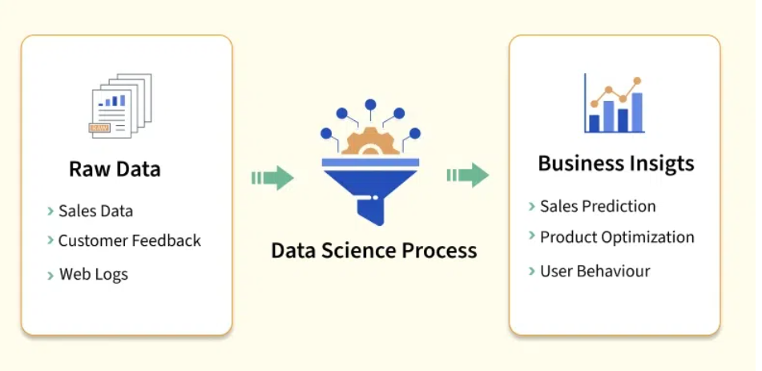

Slide 5
Steps involved in Data Science
Data Collection: Gathering raw data from various sources, such as databases, sensors or user interactions.
Data Cleaning: Ensuring the data is accurate, complete and ready for analysis.
Data Analysis: Applying statistical and computational methods to identify patterns, trends or relationships.
Data Visualization: Creating charts, graphs and dashboards to present findings clearly.
Decision-Making: Using insights to inform strategies, create solutions or predict outcomes.

Slide 6
Data Science Lifecycle
The Data Science Lifecycle describes the steps followed to solve a problem using data. It is an iterative process (steps can repeat).
Step 1: Problem Understanding
Understand what problem needs to be solved
Define objectives clearly
Example: Predict whether a student will pass or fail based on attendance and marks.

Slide 7
Step 2: Data Collection
Gather data from different sources such as:
Databases
Surveys
Sensors
Websites
Excel/CSV files
Example: Collect student attendance, internal marks, and previous results.

Slide 8
Step 3: Data Cleaning (Preprocessing)
Remove:
Missing values
Duplicate data
Incorrect entries
Convert data into usable format
This step is very important because dirty data gives wrong results.

Slide 9
Step 4: Exploratory Data Analysis (EDA)
Study data using:
Tables
Graphs
Charts
Find patterns, trends, and relationships
Example: Check if attendance affects student performance.

Slide 10
Step 5: Model Building
Apply machine learning algorithms such as:
Linear Regression
Decision Trees
K-Means
Naive Bayes
Train the model using available data

Slide 11
Step 6: Model Evaluation
Check model accuracy and performance
Use metrics like:
Accuracy
Precision
Recall

Slide 12
Step 7: Deployment & Decision Making
Use the model in real-world applications
Take decisions based on insights
Example: Identify weak students early and provide extra support.

Slide 13
Real Life Example of Data Science
E-Commerce: Recommender systems suggest products by analyzing browsing history and user behavior patterns.
Streaming Platforms: Machine learning models recommend movies and videos based on watch duration and engagement metrics.
Banking and Finance: Fraud detection systems flag unusual transaction activity using anomaly-based classification.

Slide 14
Healthcare Diagnostics: Predictive models analyze medical scans to assist doctors in early disease detection and treatment decisions.
Ride-Sharing: Algorithms estimate fares and optimal routes by evaluating traffic conditions and supply-demand ratios.
Social Media: Sentiment analysis examines user posts to understand public opinion on brands, events and trends

Slide 15
Significance of Data Science
Programming: Proficiency in programming languages like Python, R or SQL is crucial for analyzing and processing data effectively.
Statistics and Mathematics: A strong foundation in statistics and linear algebra helps in understanding data patterns and building predictive models.
Machine Learning: Knowledge of machine learning algorithms and frameworks is key to creating intelligent data-driven solutions.
Data Visualization: The ability to present data insights through tools like Tableau, Power BI or Matplotlib ensures findings are clear and actionable.

Slide 16
Data Wrangling: Skills in cleaning, transforming and preparing raw data for analysis are vital for maintaining data quality.
Big Data Tools: Familiarity with tools like Hadoop, Spark or cloud platforms helps in handling large datasets efficiently.
Critical Thinking: Analytical skills to interpret data and solve problems creatively are essential for uncovering actionable insights.
Communication: The ability to explain complex data findings in simple terms to stakeholders is a valuable asset.

Slide 17
Types and sources of data
In the era of big data, the ability to harness and analyze vast amounts of information has become a cornerstone of innovation across industries.
Data collection serves as the critical first step in this process, laying the foundation for extracting meaningful insights from raw information.
By systematically gathering data from diverse sources, whether structured like numerical records or unstructured like text, audio, or video, organizations can transform raw data into actionable knowledge.

Slide 18
What is Data Collection?
Data collection is the process of acquiring, collecting, extracting, and storing a voluminous amount of data,
It may be in a structured or unstructured form like text, video, audio, XML files, records, or other image files used in later stages of data analysis.
“Data collection” is the initial step before starting to analyze the patterns or useful information in the data.
The data that is to be analyzed must be collected from different valid sources.

Slide 19
The data that is collected is known as raw data, which is not useful now, but after cleaning the impure and utilizing that data for further analysis forms information, the information obtained is known as “knowledge”.
Knowledge has many meanings like business knowledge or sales of enterprise products, disease treatment, etc.
The main goal of data collection is to collect information-rich data.
Data collection starts with asking some questions such as what type of data is to be collected and what is the source of collection.

Slide 20
Most of the data collected are of two types
“Qualitative data“ which is a group of non-numerical data such as words, sentences mostly focus on behavior and actions of the group.
Another one is “quantitative data” which is in numerical forms and can be calculated using different scientific tools and sampling data.

Slide 21
The actual data is then further divided mainly into two types known as:
Primary data
Secondary data

Slide 22
Primary data
The data which is Raw, original, and extracted directly from the official sources is known as primary data.
Data is collected directly by performing techniques such as questionnaires, interviews, and surveys.
Data collected must be according to the demand and requirements of the target audience on which analysis is performed otherwise it would be a burden in the data processing.
Few methods of collecting primary data (next slide)

Slide 23
Interview method:
The data collected during this process is through interviewing the target audience by a person called interviewer.
The person who answers the interview is known as the interviewee.
Some basic business or product related questions are asked and noted down in the form of notes, audio, or video and this data is stored for processing.
These can be both structured and unstructured like personal interviews or formal interviews through telephone, face to face, email, etc.

Slide 24
Survey method:
The survey method is the process of research where a list of relevant questions are asked and answers are noted down in the form of text, audio, or video.
The survey method can be obtained in both online and offline mode like through website forms and email.
Then that survey answers are stored for analyzing data. Examples are online surveys or surveys through social media polls.

Slide 25
Observation method:
The observation method is a method of data collection in which the researcher keenly observes the behavior and practices of the target audience using some data collecting tool
Stores the observed data in the form of text, audio, video, or any raw formats.
In this method, the data is collected directly by posting a few questions on the participants.
For example, observing a group of customers and their behavior towards the products.
The data obtained will be sent for processing.

Slide 26
Experimental method:
The experimental method is the process of collecting data through performing experiments, research, and investigation.
The most frequently used experiment methods are CRD, RBD, LSD, FD.
CRD - Completely Randomized design is a simple experimental design used in data analytics which is based on randomization and replication. It is mostly used for comparing the experiments.
RBD - Randomized Block Design is an experimental design in which the experiment is divided into small units called blocks.

Slide 27
Secondary data
Secondary data is the data which has already been collected and reused again for some valid purpose.
This type of data is previously recorded from primary data and it has two types of sources named internal source and external source.
Internal source:
These types of data can easily be found within the organization such as market record, a sales record, transactions, customer data, accounting resources, etc.
The cost and time consumption is less in obtaining internal sources.

Slide 28
External source:
The data which can’t be found at internal organizations and can be gained through external third party resources is external source data.
The cost and time consumption is more because this contains a huge amount of data.
Examples of external sources are Government publications, news publications, Registrar General of India, planning commission, international labor bureau, syndicate services, and other non-governmental publications.

Slide 29
Other sources:
Sensors data: With the advancement of IoT devices, the sensors of these devices collect data which can be used for sensor data analytics to track the performance and usage of products.
Satellites data: Satellites collect a lot of images and data in terabytes on daily basis through surveillance cameras which can be used to collect useful information.

Slide 30
Web traffic: Due to fast and cheap internet facilities many formats of data which is uploaded by users on different platforms can be predicted and collected with their permission for data analysis.
The search engines also provide their data through keywords and queries searched mostly.

Slide 31
Internal Data Sources (Within an Organization)
Customer Data: Profiles, purchase history, interactions.
Financial Data: Sales figures, expenses, transactions.
Marketing Data: Campaign performance, website analytics (Google Analytics).
Operational Data: Production metrics, employee records, supply chain info.

Slide 32
External Data Sources (Outside an Organization)
Public/Open Data: Government statistics, scientific research, census data.
Social Media: Posts, comments, trends (Twitter, Facebook, etc.).
Web Data: Scraped data, website traffic, search engine queries.
Third-Party Platforms: Data from partners or specialized data providers via APIs.
IoT & Sensor Data: Real-time feeds from devices, satellites, smart products.

Slide 33
Secondary Data (Pre-existing)
Internal: Company databases, reports, documents.
External: Published research, industry reports, government publications.
Technical Data Formats & Access Methods
Structured Data: Databases (SQL, NoSQL), spreadsheets (CSV, Excel).
Unstructured/Semi-structured: Text (JSON, XML), images, audio, video.
Access: APIs, Web Scraping, File Transfer Protocols (FTP).

Slide 34
Visualizing data patterns using histograms
A histogram is a type of graphical representation used in statistics to show the distribution of numerical data.
It looks somewhat like a bar chart, but unlike bar graphs, which are used for categorical data, histograms are designed for continuous data, grouping it into logical ranges, which are also known as "bins."
A histogram helps in visualizing the distribution of data across a continuous interval or period which makes the data more understandable and also highlights the trends and patterns.

Slide 35
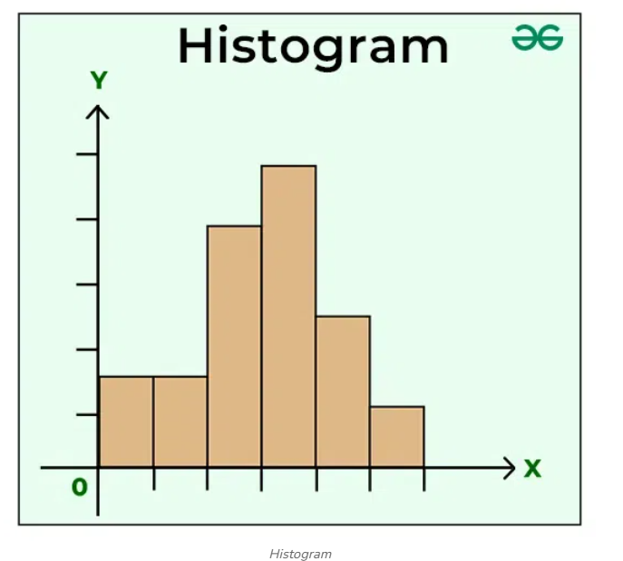

Slide 36
Representation of Data in Histogram
In a histogram, data is grouped into continuous number ranges, and each range corresponds to a vertical bar.
Horizontal axis displays the number range.
Vertical axis (frequency) represents the amount of data present in each range.
It allows us to assess where the values are concentrated, what the extremes are, and whether there are any gaps or anomalous values.

Slide 37
A Histogram is similar to a vertical bar graph, however, the distinction is that a Histogram has no space between the bars, but a bar graph does.
A histogram is a graph that shows the distribution of data.
It resembles a sequence of interconnected bars.
Each bar represents a range of values, and its height indicates how many data points are inside that range.

Slide 38
Computer Clusters
Cluster computing is attracting the attention of researchers including system developers, network engineers, academics and software designers.
A computer cluster is defined as a single logical unit which consist of several computers that are linked through a fast local area network (LAN).
The components of a cluster, which is commonly termed as nodes, operate their own instance of an operating system.
A node usually comprises of the CPU, memory, and disk storage .
It is observed that clusters, as computing platform, is not only restricted to the scientific and engineering applications.
Many business applications are also using computer clusters. Computer Clusters are needed for Big Data.

Slide 39
Apache Hadoop
Apache Hadoop is an open-source framework used to store and process very large amounts of data (Big Data) across many computers (nodes) in a distributed manner.
In simple words: Hadoop lets you handle huge data by splitting it across multiple machines and processing it in parallel.

Slide 40
Why do we need Hadoop?
Traditional systems struggle when:
Data size becomes very large (TBs or PBs)
Data grows quickly
Data comes in different formats (text, images, logs, videos)
Hadoop solves these problems by using distributed computing.

Slide 41
Main Components of Apache Hadoop
HDFS (Hadoop Distributed File System)
Stores data across multiple machines
Breaks large files into blocks
Stores replicas of data for fault tolerance
If one machine fails, data is not lost
📌 Example: A 1 GB file is split into smaller blocks and stored on different nodes.

Slide 42
MapReduce
A programming model for processing data
Works in two steps:
Map: Breaks data into smaller parts
Reduce: Combines results to produce output
Processes data in parallel
📌 Example: Counting word frequency in millions of documents.

Slide 43
YARN (Yet Another Resource Negotiator)
Manages resources (CPU, memory)
Schedules jobs on the cluster
Allows multiple applications to run on Hadoop

Slide 44
APACHE HADOOP CORE COMPONENTS
Hadoop consists of the two following core components that are related to distributed computing:
HDFS (Hadoop Distributed File System)
Map Reduce

Slide 45
HDFS is one of the core component of Hadoop cluster and it is a distributed file system that handles huge volume of data sets.
It is based on Google's File System (GFS).
HDFS is redundant, fault tolerant and scalable. It is designed like a Master-Slave architecture.

Slide 46
The Master which is also termed as the NameNode is one which manages the file system namespace operations like opening, closing, renaming files and directories.
It is also responsible to map blocks to DataNodes along with regulating access to files by clients.
Slaves, also known as DataNodes, are accountable for attending the read and write request from the clients

Slide 47
MapReduce is a programming model that is used to process and generate large dataset .
It is responsible for parallel processing of the data on the cluster.
In fact, users have to specify a map function which processes a key/value pair.
A set of intermediate key/value pairs are then generated. As for the reduce function, all intermediate values are merged.

Slide 48
Key Concepts of HDFS
🔹Blocks
Default block size: 128 MB
Large block size reduces overhead
🔹 Replication
Each block is stored multiple times (default: 3)
Ensures fault tolerance
🔹 Master–Slave Architecture
NameNode (Master): Manages metadata (file location, permissions)
DataNode (Slave): Stores actual data blocks

Slide 49
Distributed Systems
A distributed system is a system where multiple independent computers work together and appear as one single system to the user.

Slide 50
Why Distributed Systems Are Important Today?
1⃣ Handling Huge Amounts of Data
Modern applications generate massive data (Big Data).
Single machines cannot store or process it
Distributed systems divide data and workload among many nodes
📌 Example: Hadoop storing TBs of data across multiple serve

Slide 51
High Performance & Faster Processing
Tasks are executed in parallel
Multiple machines work at the same time
Reduces execution time
📌 Example: Spark processing large datasets much faster using parallelism

Slide 52
Scalability
Distributed systems are easily scalable:
Add more machines to increase capacity
No need to replace the whole system
📌 Example: Cloud platforms like AWS, Azure

Slide 53
Fault Tolerance & Reliability
If one node fails, others continue working
Data is replicated
System remains available
📌 Example: HDFS replicates data blocks across nodes

Slide 54
Cost Effectiveness
Uses commodity hardware
No need for expensive supercomputers
Easy maintenance and expansion

Slide 55
Real-World Applications
Big Data platforms (Hadoop, Spark)
Cloud computing
Online gaming
IoT systems
Banking and finance
Healthcare systems

Slide 56
Box plots
A Box Plot is also known as a Box and Whisker Plot and it is a graphical tool used to understand the distribution of numerical data.
It shows the median, quartiles and possible outliers in a simple visual form.
It helps compare distributions between groups with ease.
multiple groups effectively.
Identify outliers quickly and visually.
Reveal data symmetry or skewness at a glance.
Show variability clearly even for large datasets.
Provide compact summaries of data using quartiles and range.
Useful for comparing multiple groups or categories.

Slide 57
Interquartile Range (IQR)
The box in a box plot represents the Interquartile Range (IQR).
IQR=Q3​−Q1​
It covers the middle 50% of the data, making it a strong measure of spread that is resistant to extreme values.
Identifying Outliers in a Box Plot
Outliers are values that lie outside the upper and lower limits:
Lower Limit=Q1−1.5×IQRLower Limit=Q1​−1.5×IQR
Upper Limit=Q3+1.5×IQRUpper Limit=Q3​+1.5×IQR

Slide 58
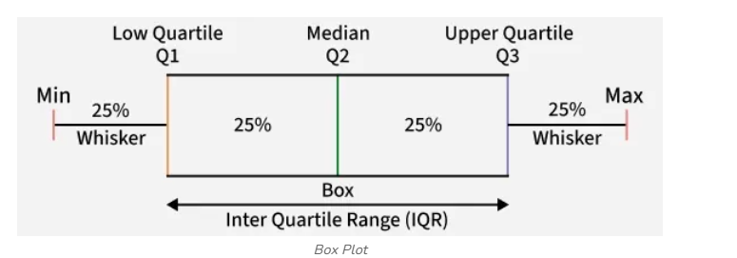
Components of a Box Plot

Slide 59
A Box Plot visually represents the five-number summary of a dataset:
Minimum: The smallest non-outlier value shown at the lower whisker end.
First Quartile (Q1): The value below which 25% of the data lies.
Median (Q2): The middle value that splits the data into two equal halves.
Third Quartile (Q3): The value below which 75% of the data lies.
Maximum: The largest non-outlier value shown at the upper whisker end.

Slide 60
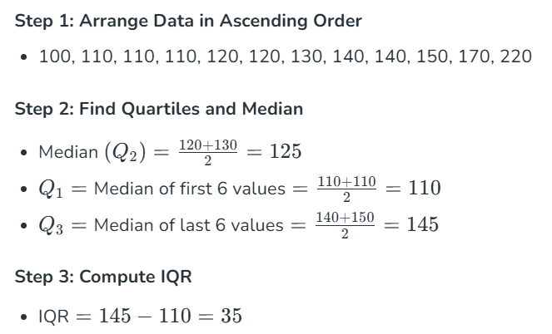
How to Create a Box Plot
Consider the runs scored by a cricket team in 12 matches: 100, 120, 110, 150, 110, 140, 130, 170, 120, 220, 140, 110.

Slide 61
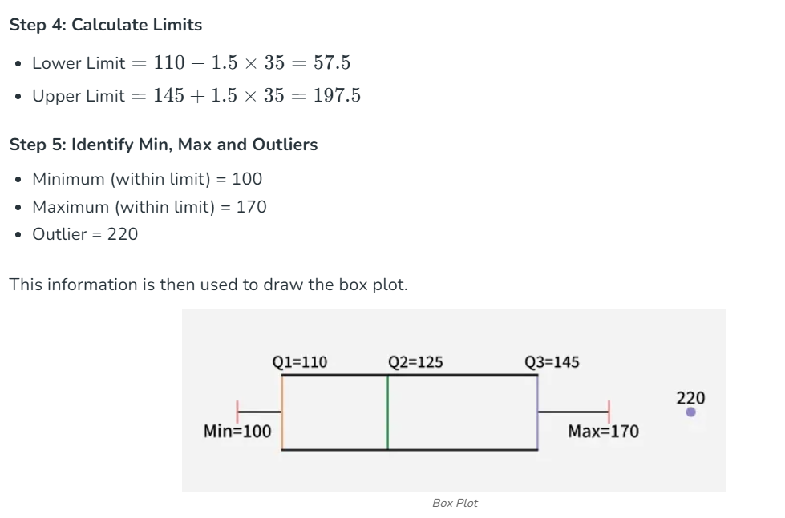

Slide 62
Box Plot Use-Cases of Box Plots
Common use-cases include:
Exploratory Data Analysis (EDA): Helps quickly detect spread, skewness and extreme values.
Comparing Multiple Groups: Useful for visualizing differences in distributions across categories.
Quality Control and Process Monitoring: Detects unusual deviations or anomalies in manufacturing and processes.
Statistical Reporting: Provides a compact visual summary for large datasets.

Slide 63
What is Correlation Analysis?
Correlation Analysis" is an important tool used to understand the type of relation between variables.
Correlation analysis is a statistical technique for determining the strength of a link between two variables. It is used to detect patterns and trends in data and to forecast future occurrences.

Slide 64
Types of Correlation
Positive Correlation: Positive correlation indicates that two variables have a direct relationship.
As one variable increases, the other variable also increases.
For example, there is a positive correlation between height and weight. As people get taller, they also tend to weigh more.
Negative Correlation: Negative correlation indicates that two variables have an inverse relationship.
As one variable increases, the other variable decreases. For example, there is a negative correlation between price and demand. As the price of a product increases, the demand for that product decreases.
Zero Correlation: Zero correlation indicates that there is no relationship between two variables.
The changes in one variable do not affect the other variable.
For example, there is zero correlation between shoe size and intelligence.

Slide 65
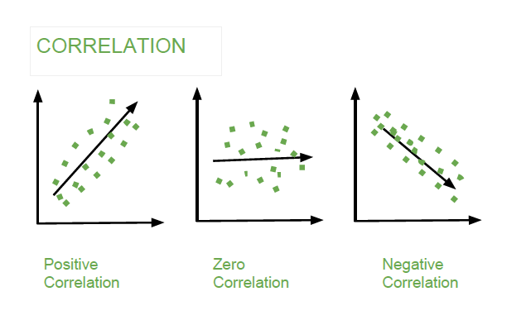

Slide 66
A positive correlation indicates that the two variables move in the same direction, while a negative correlation indicates that the two variables move in opposite directions.
The strength of the correlation is measured by a correlation coefficient, which can range from -1 to 1.
A correlation coefficient of 0 indicates no correlation, while a correlation coefficient of 1 or -1 indicates a perfect correlation.

Slide 67
Characteristics of Big Data (6V)
In recent years, Big Data was defined by the “3 Vs” but now there are “6 Vs” of Big Data which are also termed as the characteristics of Big Data.
These six characteristics help define what Big Data really means and how it can be managed effectively.

Slide 68
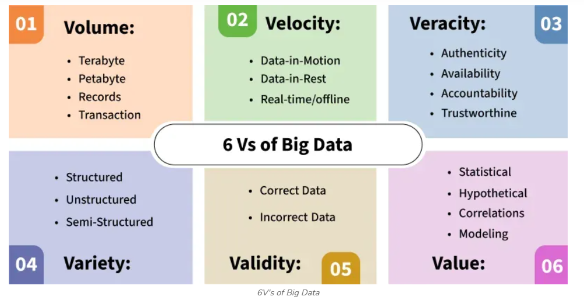

Slide 69
1. Volume – Scale of Data
The name ‘Big Data’ itself is related to a size which is enormous.
Volume is a huge amount of data.
To determine the value of data, size of data plays a very crucial role.
If the volume of data is very large, then it is actually considered as a ‘Big Data’.

Slide 70
This means whether a particular data can actually be considered as a Big Data or not, is dependent upon the volume of data.
Hence while dealing with Big Data it is necessary to consider a characteristic ‘Volume’.
Example: In the year 2016, the estimated global mobile traffic was 6.2 Exabytes (6.2 billion GB) per month.
Also, by the year 2026 we will have almost 50000 Exabytes of data.

Slide 71
2. Velocity – Speed of Data
Velocity refers to the high speed of accumulation of data.
In Big Data velocity data flows in from sources like machines, networks, social media, mobile phones etc. There is a massive and continuous flow of data.
This determines the potential of data that how fast the data is generated and processed to meet the demands. Sampling data can help in dealing with the issue like ‘velocity’.
Example: There are more than 3.5 billion searches per day are made on Google. Also, Facebook users are increasing by 22%(Approx.) year by year.

Slide 72
3. Variety – Diversity of Data
It refers to nature of data that is structured, semi-structured and unstructured data. It also refers to heterogeneous sources.
Variety is basically the arrival of data from new sources that are both inside and outside of an enterprise. It can be structured, semi-structured and unstructured.

Slide 73
Structured data: This data is basically an organized data. It generally refers to data that has defined the length and format of data.
Semi- Structured data: This data is basically a semi-organised data. It is generally a form of data that do not conform to the formal structure of data. Log files are the examples of this type of data.
Unstructured data: This data basically refers to unorganized data. It generally refers to data that doesn’t fit neatly into the traditional row and column structure of the relational database.
Texts, pictures, videos etc. are the examples of unstructured data which can’t be stored in the form of rows and columns.

Slide 74
4. Veracity – Trustworthiness of Data
It refers to inconsistencies and uncertainty in data, that is data which is available can sometimes get messy and quality and accuracy are difficult to control.
Big Data is also variable because of the multitude of data dimensions resulting from multiple disparate data types and sources.
Example: Data in bulk could create confusion whereas less amount of data could convey half or Incomplete Information.

Slide 75
5. Value – Usefulness of Data
After having the 4 V’s into account there comes one more V which stands for Value.
The bulk of Data having no Value is of no good to the company, unless you turn it into something useful.
Data in itself is of no use or importance but it needs to be converted into something valuable to extract Information.
Hence, you can state that Value is the most important V of all the 6V’s.

Slide 76
6. Variability – Inconsistency of Data
Variability refers to the changes in data flow rates, formats, or meanings over time.
For instance, during sales events or trending news, data may spike drastically.
Additionally, words or behavior may have different meanings in different contexts, making interpretation harder.
Example: if you are eating same ice-cream daily and the taste just keep changing.
Or A tweet saying "bad" might be negative, or in slang, it could mean "good." This inconsistency must be addressed when analyzing large, dynamic datasets.

Slide 77
Big Data Ecosystem
With the advances in technology and the rapid evolution of computing technology, it is becoming a very tedious to process and manage huge amount of information without the use of supercomputers.
There are some tools and techniques that are available for data management like Google BigTable, Data Stream Management System (DSMS), NoSQL amongst others.
However, there is an urgent need for companies to deploy special tools and technologies that can be used to store, access, analyse and large amounts of data in near-real time.

Slide 78
Big Data cannot be stored in a single machine and thus, several machines are required.
Common tools that are used to manipulate Big Data are Hadoop, MapReduce, and BigTable.
These tools are able to process large amount of data efficiently

Slide 79
End of Chapter

